Slide 1
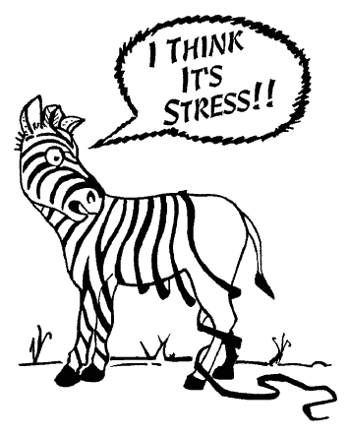
Stress Management

Slide 2

What is stress
Stress is the automatic response to any physical or mental demand placed on a person
Adrenaline is a chemical naturally produced in our body as a response to stress
Fight or flight responses is elicited

Slide 3
Is all stress bad?
Moderate level of stress may actually improve performance and efficiency
Too little stress may result in boredom
Too much stress may cause an unproductive anxiety level

Slide 4
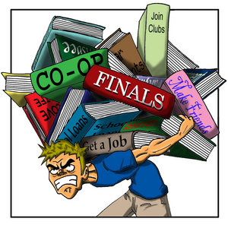
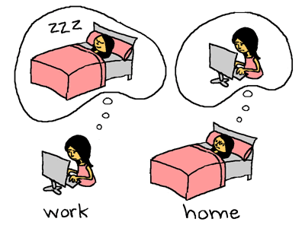
Identifying Stressors
Situations, Activities, and relationships that causes “trauma “ to one’s physical, emotional, or psychological self

Slide 5
Stressors
School – homework, too much information, pressure during exams, unhealthy competition in class
Work – deadlines, a pressuring boss, lazy colleagues, biting off more than you can chew
Family – an unhappy spouse, bickering parents, troublesome children
Relationship – inadequate communication, a needy partner
Legal -
Finances – bills, fees, retirement
Health /illness – ill health, physical or mental challenges
Living situation – uncomfortable, unhygienic, living with in-laws
Environment - competitive, insecure, peer pressure

Slide 6
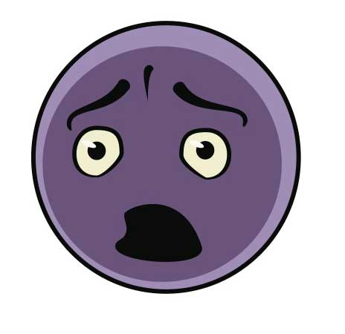
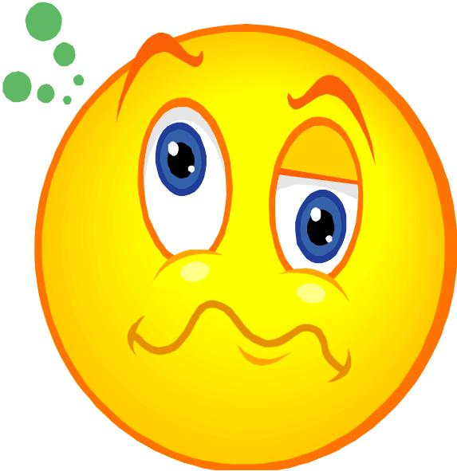
Body
Headaches
Frequent illness
Fatigue
Muscle spasms
Breathing problems
Weight loss / gain
Mind
Worrying
Impaired judgment
Indecision
Nightmares
Negativity
Muddled thinking

Slide 7
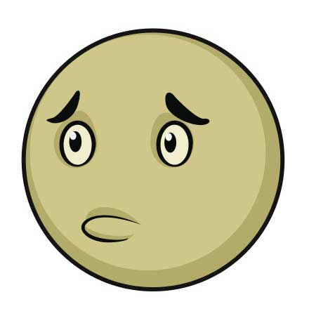
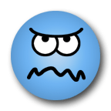
Emotions
Loss of confidence
Indifference
Alienation
Irritability
Fussy
Apprehension
Behaviour
Accident prone
Loss of appetite
Over eating
Insomnia
Drinking
Smoking

Slide 8
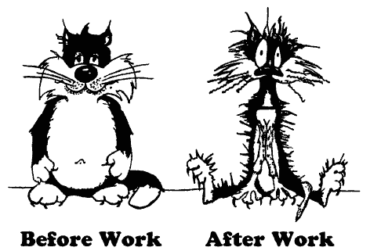
Managing Stress
Stress Relief Strategies
Take a nap
Eat well
Get organized
Set a realistic goal
Develop a work flow
Stay involved
Take a break
Exercise
Laugh it off
PUT THE GLASS DOWN
- Yoga
- Meditation
- Counseling
- Talk therapy
- Life coaching

Slide 9
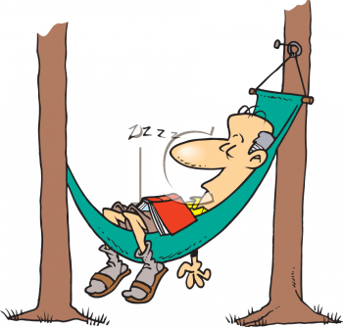
Other helpful tips
Changing perceptions and expectations
Avoid Procrastination
Set Boundaries
Don’t compromise your /Beliefs
Scheduled “Me Time”

Slide 10

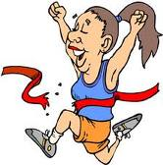
Benefits of stress management
Physical health gets better – more energy and stamina
Emotions stabilized – positive attitude, hopeful /happier
Ability to focus improved - able to earn and achieve

